Slide 4

About Us
Four Inc. is a premier technology provider that enables government customers with streamlined access to mission-critical IT while helping OEMs and their partners win and grow in the U.S. Public Sector. Backed by industry expertise, value-add solutions and distribution, and a seamless partnership, Four Inc. delivers lasting value across the entire government technology ecosystem.

Slide 5
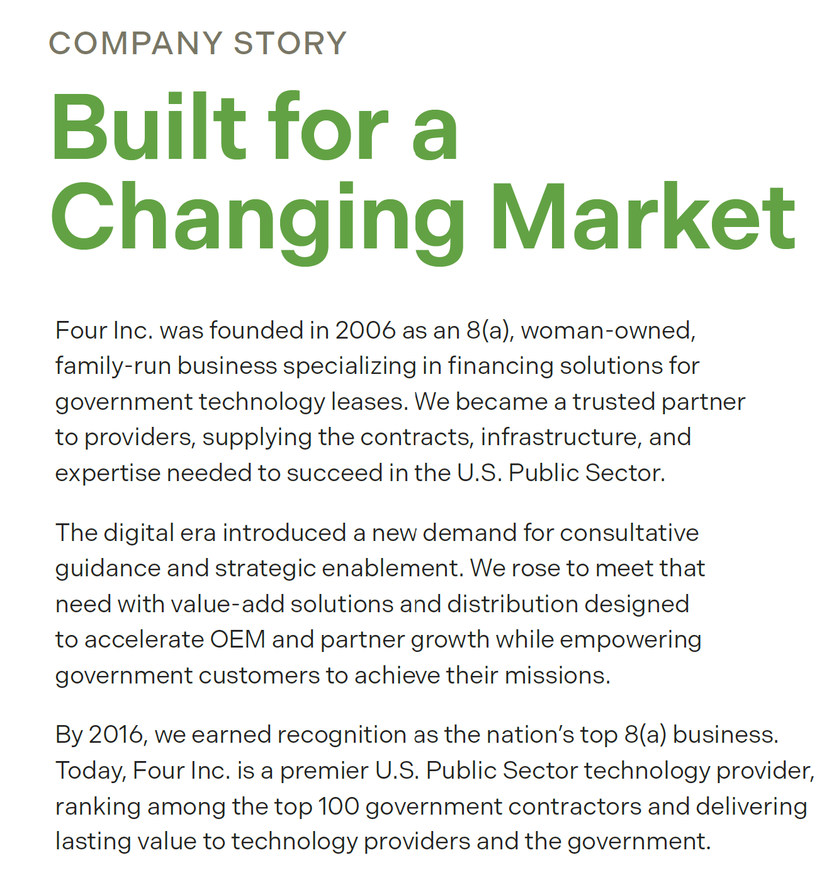

Overview
September 2024
Sverica made a strategic growth investment in Four Inc.
Frank Young, Managing Partner at Sverica and Michael Dougherty, Principal at Sverica serve on Four Inc.’s Board alongside Art Richer and Jeff Nolan.
Four Inc. Benefits:
Expanded Resources and Expertise: Sverica Capital's acquisition of Four Inc. brings enhanced resources and strategic guidance, enabling the company to scale its operations and better serve its customers.
Increased Market Reach: With Sverica's support, Four Inc. can expand its footprint and strengthen its presence in the public sector IT market, opening new opportunities for growth.
Commitment to Continuity: Four Inc. will continue its aggregation model with no changes to day-to-day operations, ensuring seamless service for partners and customers.

Slide 6
Core Values
OUR VALUES AT A GLANCE.
Integrity
Excellence
Innovation
Better Together
Growth
Compassion

Slide 7
Integrity
Integrity is the practice of being honest, ethical, and consistent in everything we do, especially when no one is watching. This core value builds trust, fosters accountability, and promotes a positive work culture.
Integrity in Action:
Encouraging open and honest communication, even when mistakes occur, and taking accountability for actions to establish a greater sense of trust.
Committing to do what's right by the company, our customers, and our OEMs in alignment with our moral principles and ethical standards.
Maintaining confidentiality by protecting sensitive company information as well as respecting privileged matters shared between employees.

Slide 8
Excellence means going above and beyond in everything we do.
We want to deliver in not just the ordinary, but also in the extra-ordinary.
It is being detail-oriented and meticulous, especially in how we serve our customers and OEMs, ensuring that every interaction reflects care and quality.
Excellence
Excellence in Action:
Being meticulous in our quotes, awards, orders, and proposals; treating even small details with care and transforming “trash into treasure.”
Establishing clear structures and standards in our processes, such as internal trainings, to start people off right and instill excellence from the beginning.
Aligning with both customers and OEMs by understanding their priorities and consistently delivering outstanding outcomes for all parties.
Committing to collaboration by supporting teammates to prevent burnout, sharing the load during busy times, and encouraging open idea-sharing and feedback to build trust and teamwork.

Slide 9
Innovation means that we embrace creativity, continuous
learning, and forward-thinking to grow as individuals and as a team.
We stay adaptable by being open to change, exploring new
technologies, and finding smarter, more efficient ways to work
and solve problems together – then putting those ideas into action.
Innovation
Innovation in Action:
Promoting a culture where creativity and new ideas are embraced and encouraged at every level.
Creating cross-departmental teams to generate fresh ideas for improving workflows and collaboration, then implementing changes.
Encouraging everyone to challenge the norm and contribute fresh ideas, not being afraid of change but actively driving change as the business evolves.

Slide 10
Growth means we prioritize learning, continuous development, and expansion - both as individuals and as an organization - so that we can achieve higher performance and greater impact as individual contributors and as an industry- leading organization.
Growth
Growth in Action:
Setting stretch goals to drive business growth and encourage teams to expand their skills while learning from successes and failures.
Recognizing and celebrating achievements that reflect personal and organizational progress.
Offering ongoing professional development, mentorship, and learning opportunities to support continuous employee development aligned with Four Inc.’s growth goals.

Slide 11
Compassion requires approaching others with respect, kindness, and empathy, both personally and professionally. As we grow, we may not all have the same viewpoints, but we always approach each other with respect and understanding.
Compassion
Compassion in Action:
Giving grace and support to each other when we experience challenges in our personal and professional lives (which looks different for every person).
Evaluating values of business partners when deciding whether to engage with them.
Engaging in respectful conflict when we disagree.
When making business decisions, respectfully considering the benefit of the whole while keeping in mind kindness and care for the individual.

Slide 12
Better
Together
Better together signifies a commitment to culture and
values-focused teamwork, with a "we-over-me" mentality.
We are a team defined by its community spirit where kindness,
transparency, and compassion fuel collaboration.
Better Together in Action:
When working with a partner, integrating with the team and becoming one.
Working hard and doing our part to set our team members and the organization up for success.
Practicing a helper-based culture, backing one another up and lending a hand regardless of team/department alignment.
Understanding our role as a team member in our community (such as Corporate Social Responsibility).
Openly and regularly communicating with colleagues and stakeholders to ensure collaboration, transparency, and team alignment.

Slide 13

The Four Inc. Way
Our Guiding Principles
Your Public Sector Technology Provider
Make other people successful.
Continuously improve yourself.
Demonstrate pride in your work.
Lead with a positive outlook.
Demonstrate professionalism and respect.
Bloom where you are planted.
Align your word, intent, and deed.
Drive your success.
Find opportunity in change.
Be collaborative, not combative.

Slide 14
  1. Make other people successful.
  We contribute to the growth, performance, and well-being of our colleagues, team members, and organization as a whole. We empower others, celebrating wins and promoting a collaborative environment.
  2. Continuously improve yourself.
  We are committed to ongoing personal and professional growth to become more effective, adaptable, and valuable in our roles. We’re proactive in learning, reflecting, and evolving - not just for our own benefit, but also to contribute more meaningfully to our teams and to the organization.
3. Demonstrate pride in your work.
We are deeply motivated and engaged in our work. We’re continuously striving for excellence and meaningful results. We seek joy and fulfillment at work, and are proud of the work we do and standards to which we hold ourselves.
4. Lead with a positive outlook.
We are responsible for our own actions and reactions. We understand that morale is contagious and affects others around us, and we act accordingly.
5. Demonstrate professionalism and respect.
We conduct ourselves professionally, and show respect to coworkers, clients, and partners. Always.
Our Guiding Principles
Defined

Slide 15
  6. Bloom where you are planted.
  We embrace every change and challenge with purpose, grace, and open-mindedness. We don’t just adapt to our work environment, teammates, and tasks, but also thrive. We don’t need the “perfect place” to succeed at Four - we can do great work anywhere we are planted. We have the ability to thrive and grow wherever we are - to demonstrate excellence and grow personally and professionally.
  7. Align your word, intent, and deed.
  We are reliable and transparent and we do what we say we will do. We follow through on commitments and communicate if our intention changes. We operate with integrity.
  8. Drive your success.
  We take initiative — build our path, support our teammates, and create opportunities for growth. We are proactive people who own our futures, our goals, and the outcomes we deliver.
  9. Find opportunity in change.
  We recognize opportunity in change, underscoring our commitment to innovation, growth, and adaptability in an everchanging environment. Our goal is to transform change into a competitive advantage. As a team, we commit to finding exciting possibilities in the midst of emerging technologies, organizational shifts, evolving priorities, and new policies.
  10. Be collaborative, not combative.
  We win with wisdom, not haste. We are thoughtful and have a team-first mindset, engaging in respectful and healthy disagreements when we feel like something is important. We are strategic about which issues we choose to escalate, using good judgment to balance team cohesion, our passionate convictions, and the best interests of the company.
Our Guiding Principles
Defined

Slide 18



Communication Tools

Slide 19



















Business Tools

Slide 20
Executive Management Team
Jeff Nolan
Executive, Vice Chair
David Stewart
CEO, President
Matt Carullo
EVP of Strategy & Corporate Dev.
Bree Burk
Vice President of
Operations
Chris Wilkinson
Executive Vice President of Sales
Chris McKinley
Sr. Director of Financed Solutions
Chris Harvey
Chief Revenue Officer (CRO)
Joanna Corcoran
Vice President of
Marketing
Katie Fionova
Director of HR & Training

Slide 21
Platform Sales Team
Chris Wilkinson
EVP of Sales
David Tong
Senior Director of Sales
Dave McDonald
Director of Sales
Simon Pierre-Louis
Sr. Manager of
Strategic Dev.
Skip Liesegang
VP Channels & Partner Alliances
Laila Dastur
Corporate Sales Director
Mark Gunst
Senior Account Manager
Dana Duque
Senior Account Manager
Sanie Warsaf
Team Lead, Strat Dev.
Sarah Chittick
SLED Director
Matt Ludeman
Team Lead, Inside Sales
Joe Rivetti
Public Sector Account Rep
Zarmeena Shaikh
Public Sector Account Rep
Martina Elia
Strat Dev Representative
Saeed Rafee
Strat Dev Representative
Stephen Hrebenach
Public Sector Account Rep
Bella Shapiro
Public Sector Account Rep
Lauren La Tour
Public Sector Account Rep
Christian DeWitt
Strat Dev Representative
Noor Popal
Strat Dev Representative
Andrew Hawley
Public Sector Account Rep
Noah Brown
Public Sector Account Rep
Zachary Segalewitz
Public Sector Account Rep
Open Position
Strat Dev Representative
Open Position
Strat Dev Representative
Elle Yulo
Public Sector Account Rep
Nels Williams
Public Sector Account Rep
Cameron Long
Public Sector Account Rep
Natalie Fitzpatrick
Public Sector Account Rep

Slide 22
Platform Sales Team
Focus Groups
Chris Wilkinson
EVP of Sales
David Tong
Senior Director of Sales
Dave McDonald
Director of Sales
Mark Gunst
Senior Account Manager
Dana Duque
Senior Account Manager
FOCUS 1
Matt Ludeman
Team Lead, Inside Sales
FOCUS 2
FOCUS 3
Joe Rivetti
Public Sector Account Rep
Zarmeena Shaikh
Public Sector Account Rep
Stephen Hrebenach
Public Sector Account Rep
Bella Shapiro
Public Sector Account Rep
Lauren La Tour
Public Sector Account Rep
Andrew Hawley
Public Sector Account Rep
Noah Brown
Public Sector Account Rep
Zachary Segalewitz
Public Sector Account Rep
Elle Yulo
Public Sector Account Rep
Nels Williams
Public Sector Account Rep
Cameron Long
Public Sector Account Rep
Natalie Fitzpatrick
Public Sector Account Rep

Slide 23
Enterprise Sales Team
Chris Harvey
CRO
Ryan Gilhooley
Senior Director of Sales
Jamie Mangum
Senior Sales Director
John Todd
Enterprise Renewals Leader
Gordon Bradley
HCL Team Lead
Caleb Lokey
Senior IBM Renewals Rep
Joseph Hazzouri
IBM/HCL Account Rep
Bob Ferrari
IBM FSI Director
John Vitkus
IBM Senior Sales Executive
Maxwell Johnson
HCL Account Rep
Caitlin Brinkley
IBM Senior Sales Executive
Patrick Manion
IBM Senior Sales Executive
Michael Morgan
IBM Senior Sales Executive
Russ Hopler
Technical Solutions Architect
Jim Bonfils
Storage Sales Director

Slide 24
Marketing Team
Joanna Corcoran
VP of Marketing
Tricia Shelley
Director of Marketing
Mike York
Director of Digital Strategy
Nora Omary
Events Marketing Manager
Lena Alkhatib
Sr. Marketing Specialist
Alex Pham
Sr. Marketing Specialist
Bridget Laychak
Marketing Coordinator

Slide 25
Operations Team
Bree Burk
VP of Operations
Ryan Murakami
Director of Contracts & Acquisition
Michael Lucas
Director of Programs & Compliance
Tommy Logan
Contract Operations Lead
Jennifer Jordan
Contracts Manager
Cody Powers
IT Specialist in Operations
Billy Cody
Senior Manager, Programs and Security in Services
Alex Francisco
Solutions Architect
Tessa Smerk
Order Ops Analyst
Digital Market TEAM
Daniel McGiffin
Program Manager in Special Projects
Brittany Ryan
Data Systems Analyst
Grayson Reigel
Order Ops Analyst
Matthew Leibrock
Program Manager in Special Projects
Zumrod Tebra
Order Ops Specialist
Charles Graham
eDiscovery Support Technician

Slide 26
Finance & Accounting Team
Chris Nguyen
Director of Finance
Cindy Davidson
Controller
Kyle Purcell
Accounts Receivable Analyst
Sam Cassels
Accounts Payable Analyst
Tony Franzonello
Accounting Associate
Greg Windsor
Finance Associate

Slide 27
Financed Solutions Team
David Stewart
CEO, President
Chris Harvey
CRO
Chris McKinley
Sr. Director of Financed Solutions
Enterprise
Sales Team
Nicole Newell
Director of Finance Sales & Operations
Toni Egan
VP Financial Solutions
John Ralston
Sr. Manager Financed Solutions & Treasury Management
Evan Maraist
Sr. Finance
Operations Analyst
Jenny Small
Sr. Contracts Manager

Slide 28
Human Resources & Admin Team
Katie Fionova
Director of HR & Training
Maria Corrales
Senior Human Resources Generalist
Emmaline Ewens
Office Manager
Open Position:
Payroll Specialist

